Slide 1
A Proposal for a Parameterized Circulating Vector Field Guidance for Fixed Wing Unmanned Aerial Vehicles
Presented by: Garrett Clem
Advisor: Jay Wilhelm
Committee: Dr. Bob Williams, Dr. David Casbeer, Dr. Maarten Uijt de Haag
Notes:
Getting started
Refreshments available
Thank audience for attending, thanks to committee (Dr. Casbeer for traveling)
Introduction to fixed wings
Problem statement /objectives
Literature review – motivated the problem statement
Phases
Timeline
Questions

Slide 2
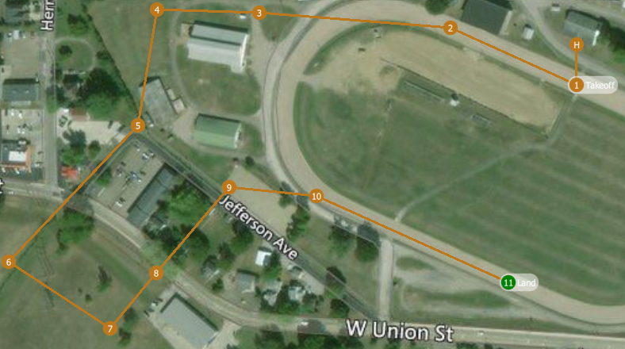
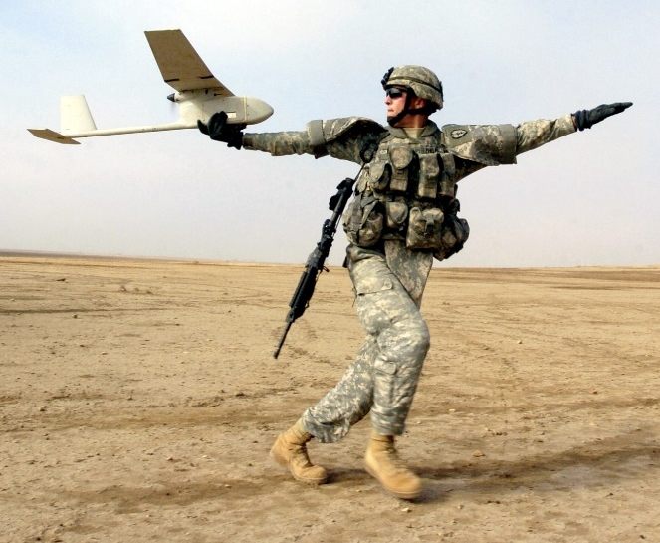
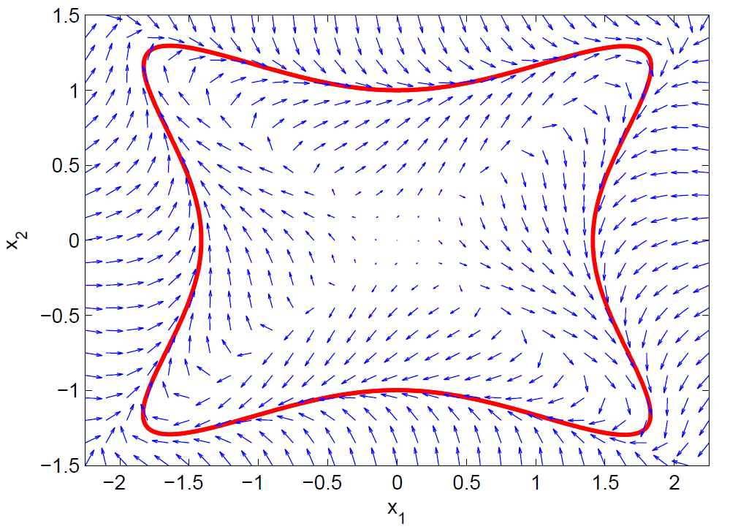
Introduction
Fixed Wing Unmanned Aerial Vehicles (UAVs)
Remotely piloted
On-board flight controller
Maintain stability
Carry out mission objectives
Follow waypoints or ground track
Waypoint navigation
Typically pre-planned at ground station
May consider known obstacles
Unknown obstacles may require waypoint re-planning
Sequential pre-planned waypoints
Hand-launched fixed wing UAV
Gradient vector field [ Goncalves, 2010]
Notes:
Fixed wing UAVs are a category of robotic aircraft
Remotely piloted with the assistance of an on-board autopilot
Autopilot maintains vehicle stability
Carry out mission objectives such as following waypoints
Waypoints are typically pre-planned before flight at a ground station
Obstacles such as buildings, mountains, and general no-fly zones may be considered during planning
During flight, unknown obstacles may be encountered which could require waypoints to be re-planned.
The UAV typically communicates with a ground station over radio to plan waypoints which may not always be possible
A possible solution is to use vector field guidance which combines path following with obstacle avoidance

Slide 3
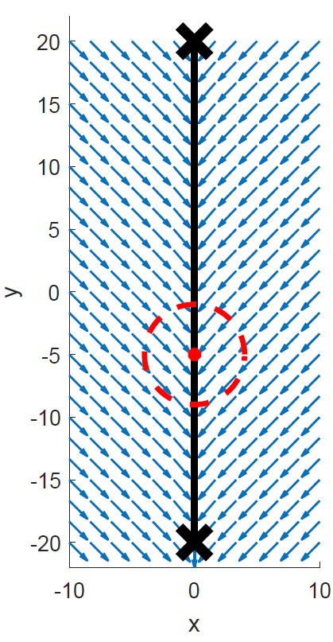
Problem Statement and Objectives
Problem Statement: Utilize vector field guidance to enable optimal obstacle avoidance without re-planning waypoints
Phase 1: Identify specific set of conditions that yield guidance singularity when summing attractive and repulsive GVFs
Phase 2: Determine GVF weighting functions that improve obstacle avoidance
Phase 3: Demonstrate GVF obstacle avoidance with ground robot experiments
Straight path vector field guidance with obstacle
Notes:
Problem statement
Guidance between waypoints produced by an attractive vector field that has both circulation and convergence components
Obstacle along the path detected after planning can be represented as a repulsive field
Summing together fields can result in singularities
This will be achieved by completing three phases. (execution of three phases)
Phase 1: Description
Phase 2: Description
Phase 3: Description

Slide 4
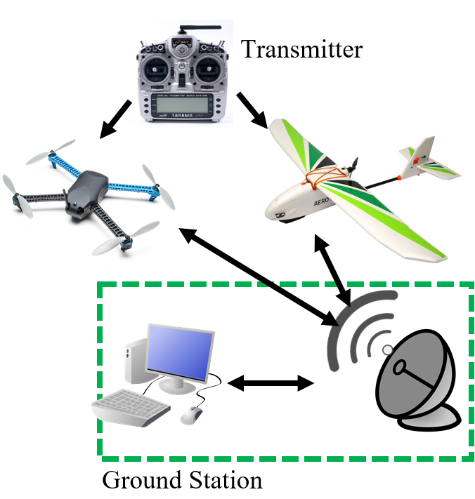
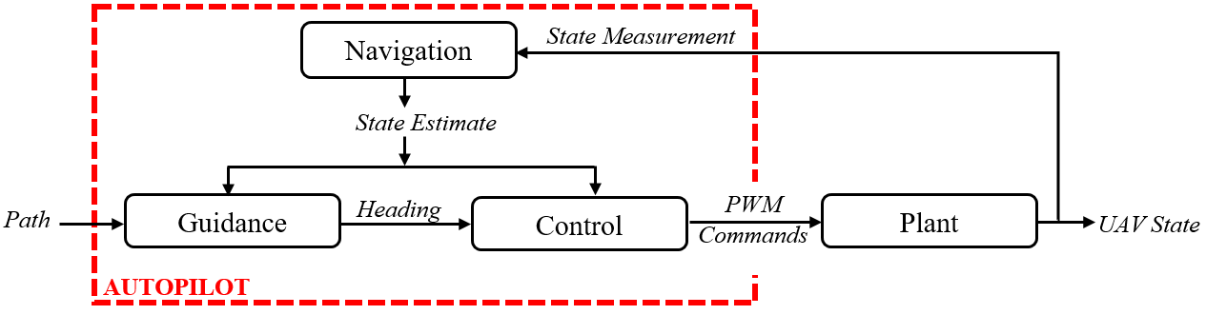
Literature Review
Unmanned Aerial System (UAS)
Aircraft
Fixed wing
Rotorcraft
Radio /Transmitter
Ground Station
Autopilot
Navigation
Guidance
Control
Notes:
UAVs are a part of a larger system called an Unmanned Aerial System which typically consists of four parts
The physical aircraft itself which typically can be categorized under one of two categories consisting of fixed wing and rotorcraft
Fixed wing UAVs typically have a larger payload and can fly long endurance missions compared to rotor craft
Rotor craft are more maneuverable and do not require a runway or launcher for deployment
Transmitters are used for direct UAV control and can be used short range
Radios can be used for long distance communication and for relaying sensor data back to a ground station
Ground stations are typically a PC equipped with software that sets vehicle parameters, collects data, and plans mission waypoints
Mission waypoints can be communicated back through the radio and sent to the autopilot which uses GNC systems to fly from waypoint to waypoint
Navigation consists of measuring the UAV state which is fed to G and C
Path, or waypoints, are fed to guidance which typically outputs a desired heading to the guidance system which actuates the UAVs controls to transition to the desired state
Guidance is where vector fields comes in

Slide 5
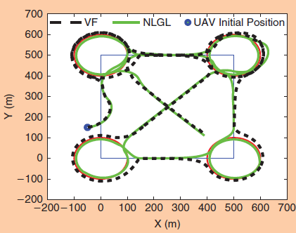
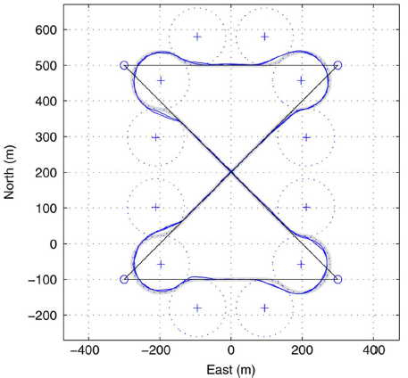
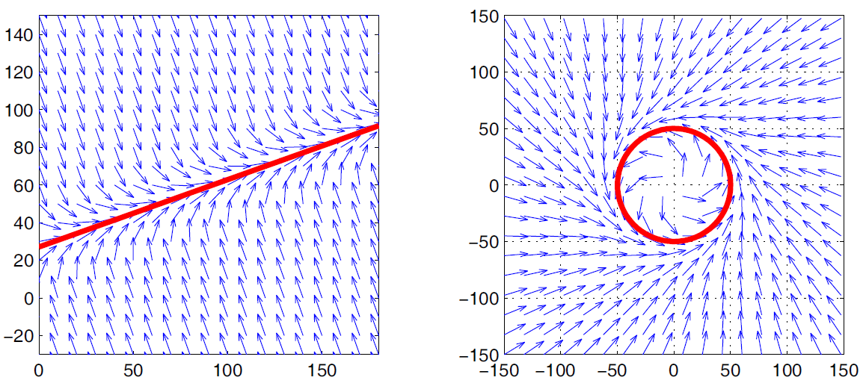
Literature Review
Guidance Methods
[Sujit et al., 2014]
Guidance provides heading reference commands
Waypoints, path following
Accurate and robust to disturbances
Vector field provided best performance
[Nelson et al., 2005]
Lyapunov vector field primitives
Asymptotically approach curve
Stitch paths together for complex behavior
UAV guidance along path via vector field [Sujit, 2014]
Switching primitives guidance for UAV [Nelson et al, 2005]
Lyapunov vector field path primitives [Nelson et al, 2005]
Notes:
Sujit et al presented a comparison between five common heading based guidance techniques (Carrot chasing, NLGL, PLOS, LQR, and Vector Field)
Guidance must be accurate (low error) and robust (rejects disturbances)
Guidance methods can fall under either waypoint or path following methods
Monty Carlo simulation of the five guidance techniques involving external wind disturbances determined that the path following vector field method had a low cross track error and was robust to external wind disturbances
Which is important for small fixed wing UAVs since winds can be expected to be 20-30% of the UAVs air speed
Nelson et al. demonstrated the construction of a lyapunov vector field for straight line a circular path primitives, which can be shown in the two figures at the bottom
The robustness of vector field is due to the converging nature of the field followed by circulation. Deviation from the path results in guidance back onto the path.
Nelson combined the use of straight line and circular primitives together to form more complex flight paths, shown in this figure
- The difficulty in using path primitives is the transition from one field to another

Slide 6
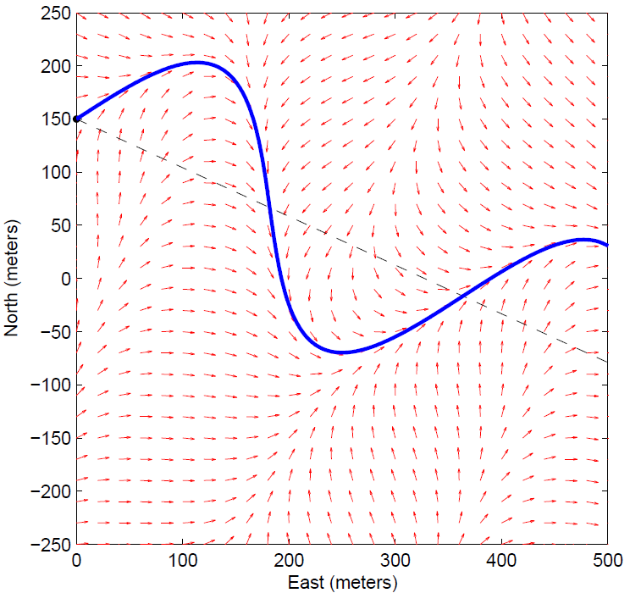
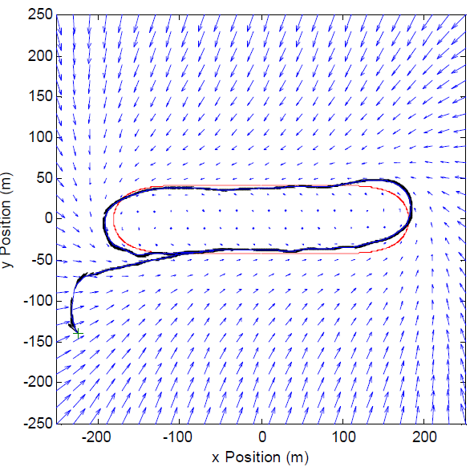
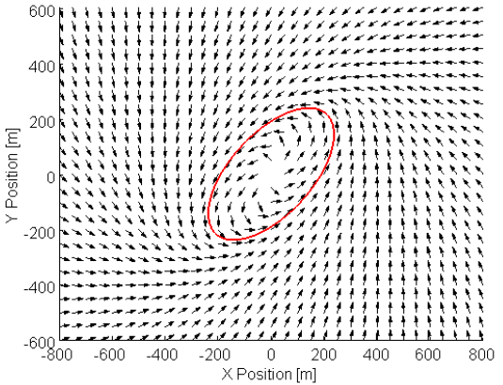
Literature Review
[Griffiths, 2006]
Expanded Nelson ‘s method for arbitrary paths
[Frew, 2007a]
Modify existing field
Non-linear coordinate transformation
[Frew, 2007b]
Modify field shape via position estimate covariance matrix
Standoff tracking uncertain targets
Lyapunov vector field guidance along curved path [Griffiths, 2006]
Non-linear coordinate transformation of stable circular Lyapunov vector field [Frew 2007]
Notes:
- Griffiths expanded on Neslon’s method and provided a lyapunov vector field for an arbitrary path, which is shown in the figure above
For closed paths, such as a loiter, Frew modified an existing circular field with non-linear coordinate transformation to produce a racetrack and elliptical pattern
Beneficial because fields already proven to converge
In the later paper, the vector field was used for tracking an uncertain target. The field was modified based on a kalman filters covariance matrix

Slide 7
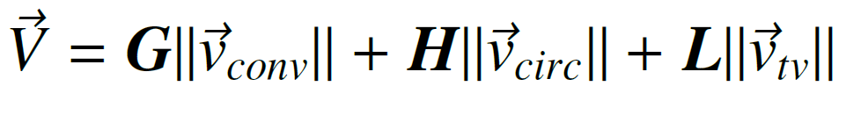
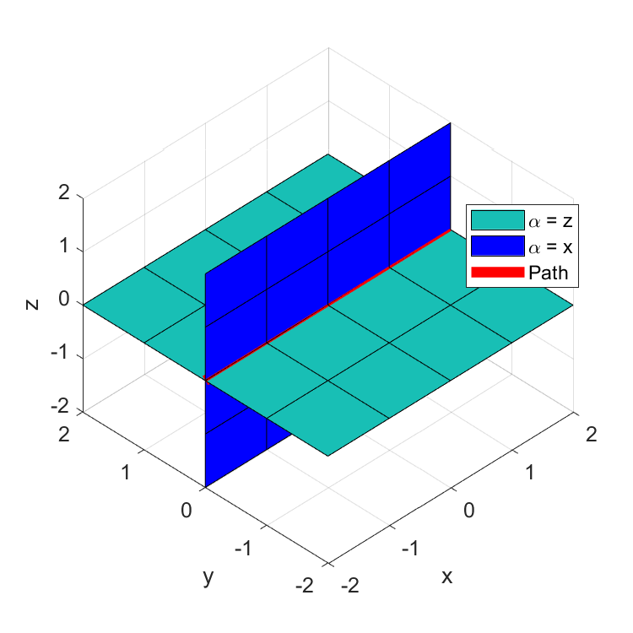
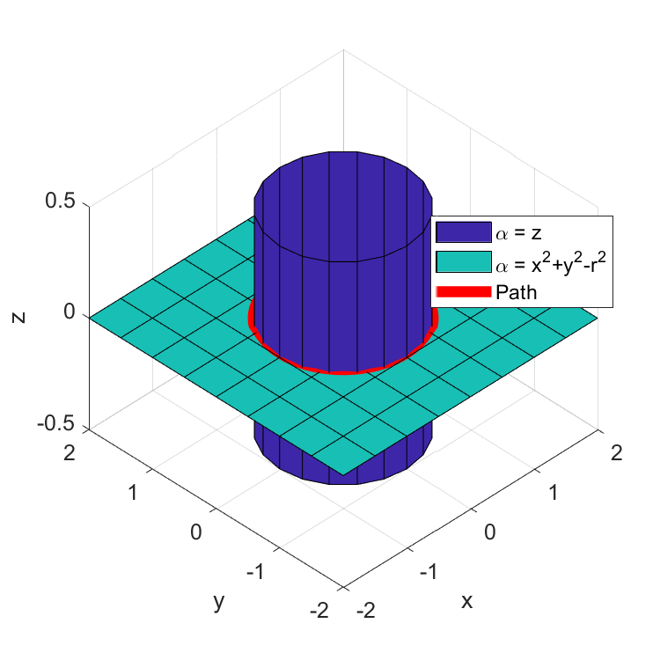
Literature Review
VF
Process
[Goncalves et al, 2009]
N-dimensional vector field
Converge and follows a path
Static
Time varying
Intersection of (n-1) surfaces
Surfaces defined by implicit functions
First order partials differentiable
Bounded second order partials
[Goncalves et al, 2010a]
Experimental validation (2d,3d robotic systems)
[Goncalves et al, 2010b]
Stability proofs of vector field
Straight path vector field converging at intersection of surfaces
VF
Process
Circular vector field converging at intersection of surfaces
Notes:
Goncalves et al presented a method for constructing an n-dimensional vector field that is guaranteed to converge and follow both static and time varying paths
Field circulate and converge at the intersection of (n-1) surfaces defined by implicit functions that must:
Have first order partials
Bounded second order partial derivatives
A vector field that converges and follows a straight line can be produced by intersecting two planes, shown above
And a vector field that converges and follows a circular path can be produced by intersecting a cylinder and a plane
Fields contain three components
Convergence
Circulation
Time varying
Other papers

Slide 8
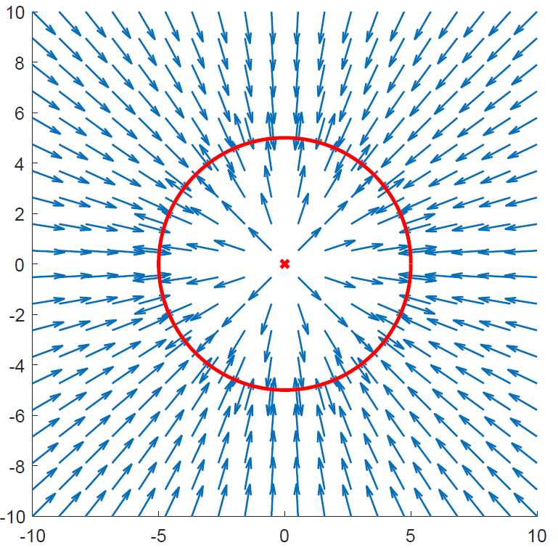
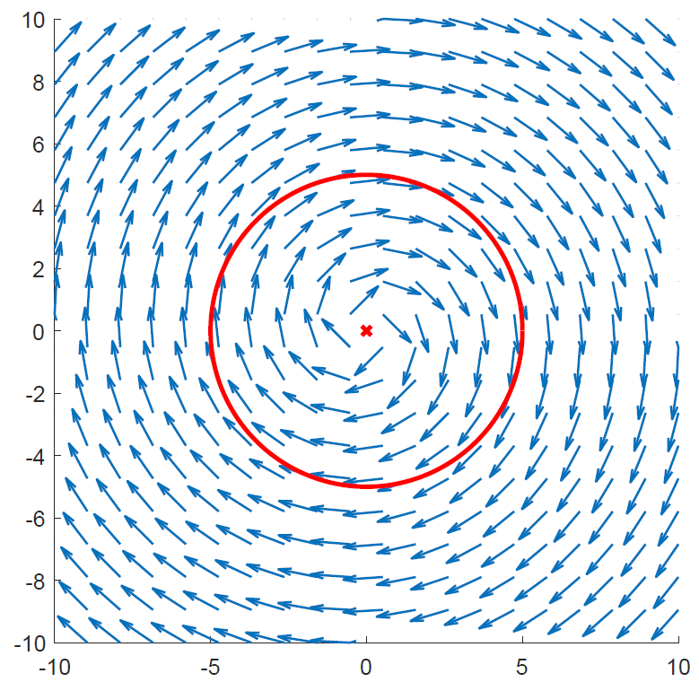
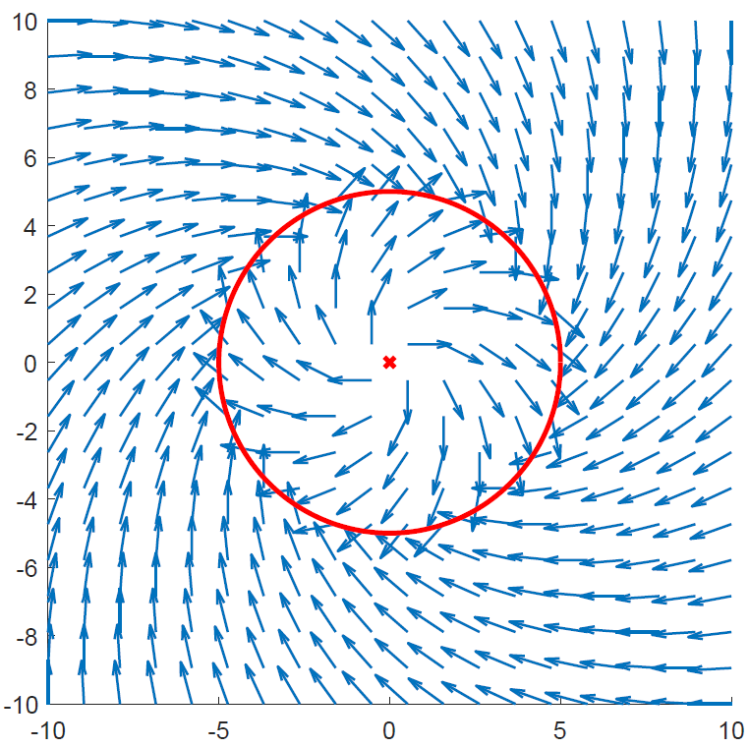
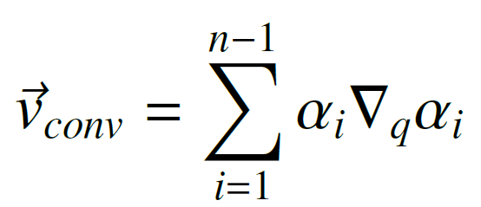
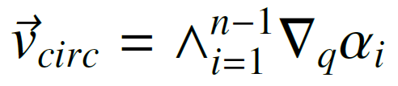
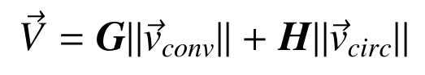
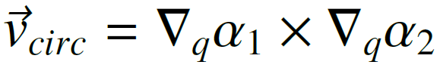
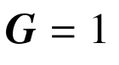
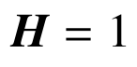
Literature Review
Normalized Convergence Normalized Circulation Total Field
Notes:
Goncalves et al presented a method for constructing an n-dimensional vector field that is guaranteed to converge and follow both static and time varying paths
Field circulate and converge at the intersection of (n-1) surfaces defined by implicit functions that must:
Have first order partials
Bounded second order partial derivatives
A vector field that converges and follows a straight line can be produced by intersecting two planes, shown above
And a vector field that converges and follows a circular path can be produced by intersecting a cylinder and a plane
Fields contain three components
Convergence
Circulation
Time varying
Other papers

Slide 9
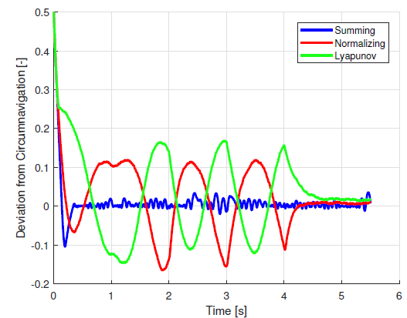
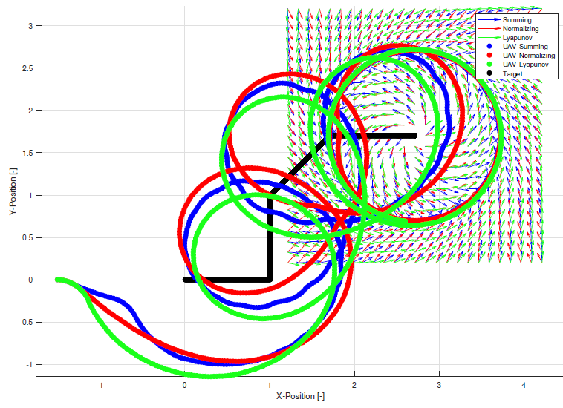
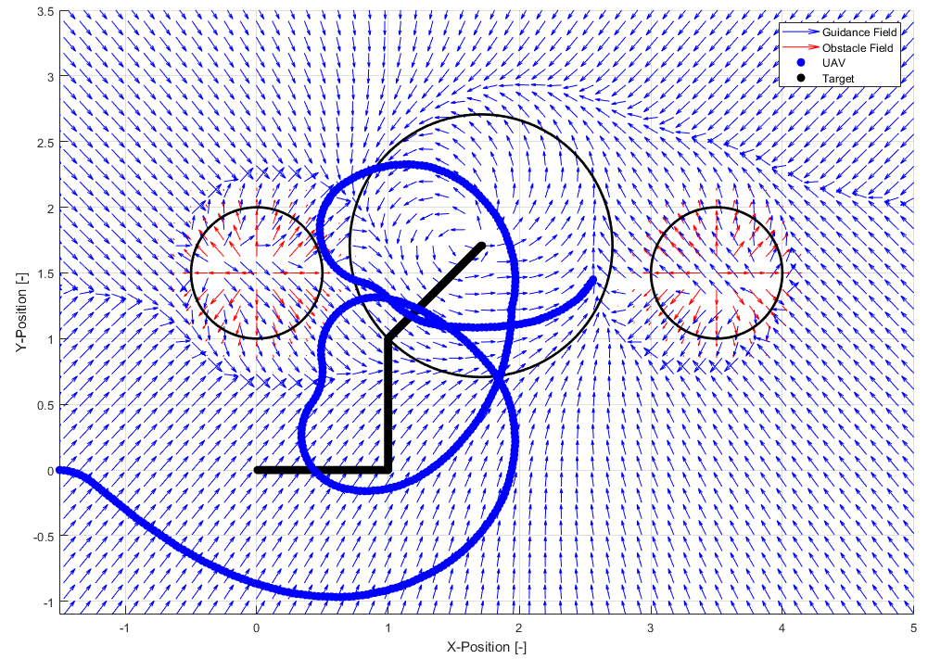
Literature Review
[Wilhelm et al. 2017]
Loiter moving target
Reduced steady-state error in comparison to Lyapunov
Obstacle Avoidance
Goal field tracked target ground vehicle
Repulsive fields representing obstacles
Fields summed resulting in guidance
Did not consider circulation to improve obstacle avoidance
Did not address singularities
GVF and Lyapunov tracking a ground target [Wilhelm et al.]
UAV tracking a ground target and avoiding obstacles [Wilhelm et al.]
Notes:
Wilhelm et al. attached a circular gradient vector field to a moving ground target resulting in a low tracking error loiter
In comparison to lyapunov vector fields by [NAME]
Obstacles were added to the simulation by placing a vector field with a negative convergence near the vehicles path
Summing together attractive loiter field and obstacle field produced a heading guidance which loitered the vehicle while avoiding obstacles
Obstacle fields only considered repulsive vectors and had zero circulation.
Summing vector fields could produce singularities where guidance vanishes (or singularity)
Discuss the three phases:

Slide 10
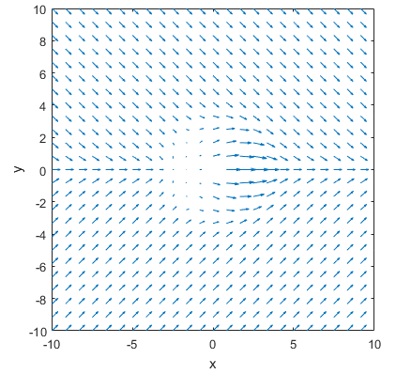
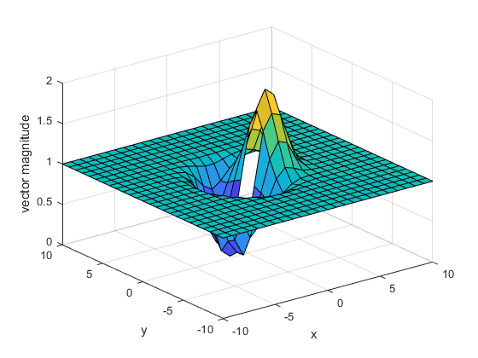
Phase 1 Overview:
Total vector field
Demonstrate zero guidance resulting from summing attractive and repulsive GVF
Path
Goal:
Objective:
Tasks:
Identify specific set of conditions that yields guidance singularity when summing attractive and repulsive GVFs
Build GVF simulation environment
Evaluate scenarios where singularities are expected
Characterize location of singularities
VF magnitude for circular obstacle on straight path
Notes:
Preliminary investigation

Slide 11
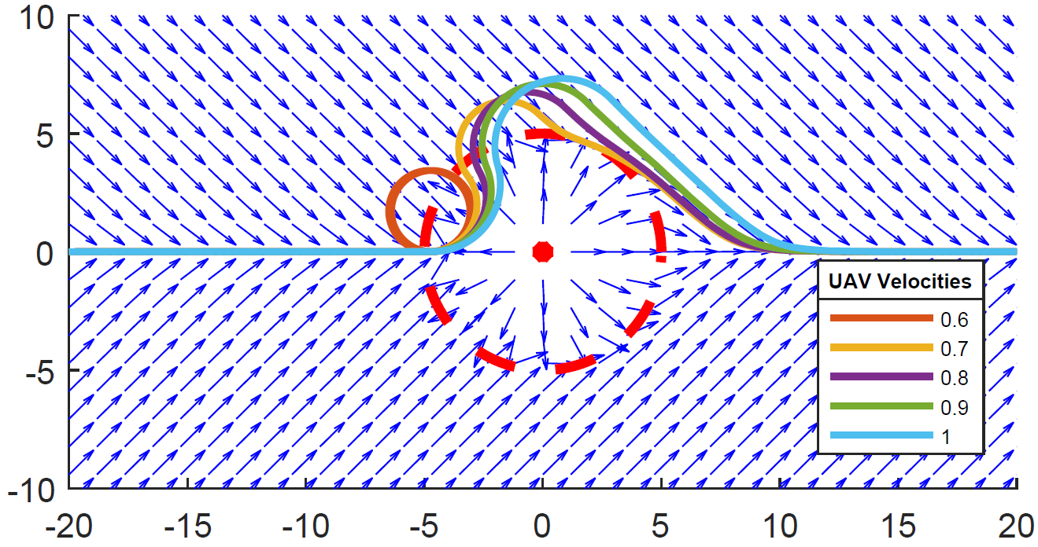
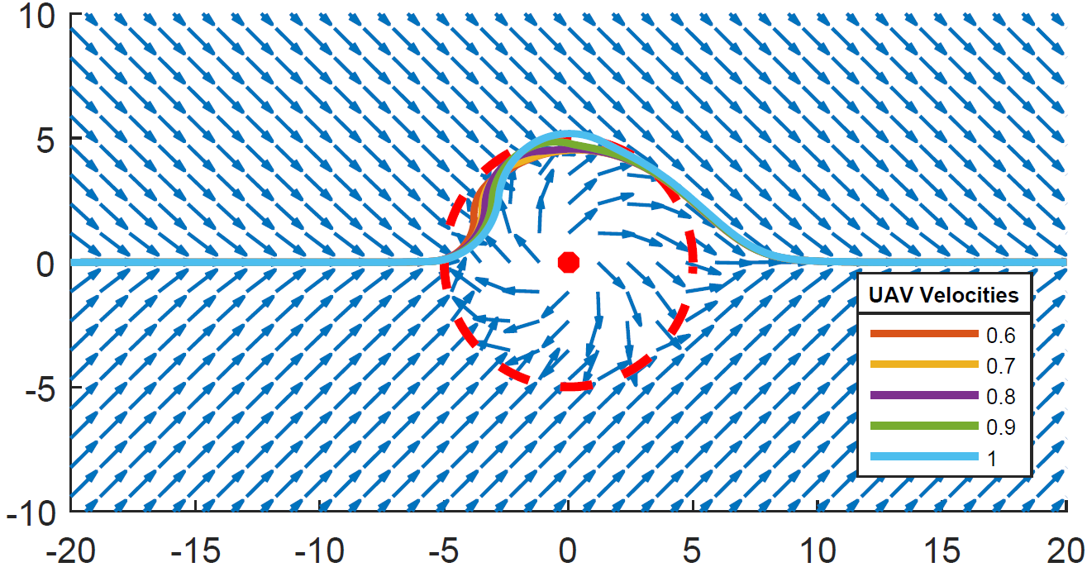
Phase 2 Overview :
Goal:
Objective:
Tasks:
Demonstrate GVF weighting functions that influence obstacle avoidance
Investigate weighting functions dependent on UAV state
Straight line vector field with circular obstacle, no circulation
Formulate circulation and convergence weights as functions of UAV state
Determine combination of GVF weights that produces optimal guidance in simulation
Straight line vector field with circular obstacle with circulation

Slide 12
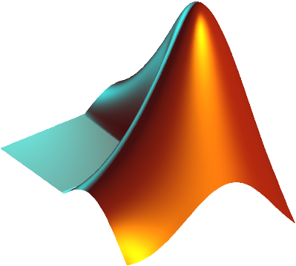
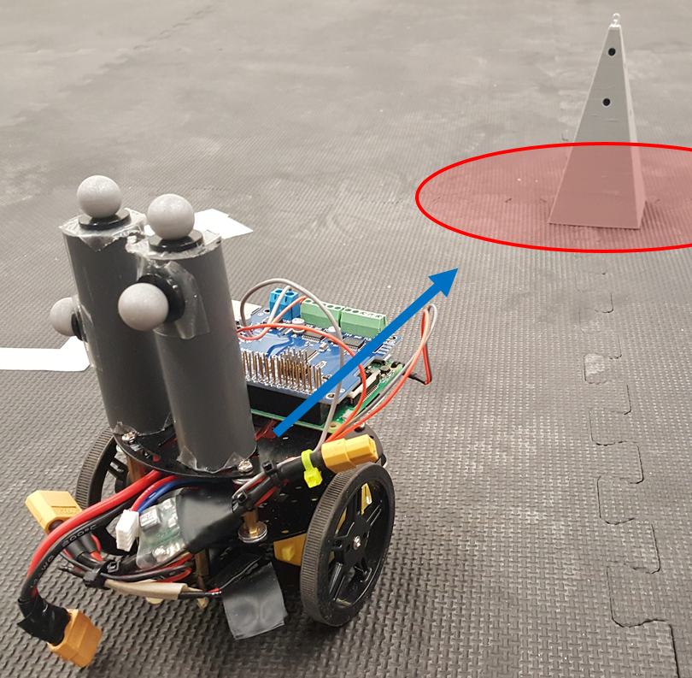
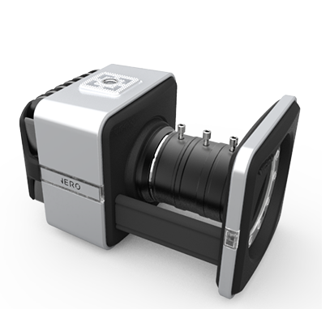
Phase 3 Overview :
MATLAB
Post process guidance performance
Demonstrate GVF obstacle avoidance with mobile robot
Goal:
Objective:
Tasks:
VICON Tracker (PC)
Data
stream
Process Monitor
(PC, python)
Validate modified GVF guidance on mobile robot platform simulating fixed wing constraints
Guidance
Control
log
State and obstacle
information
Build differential drive robot
Program robotic framework to take guidance commands
Repeat experiments performed in phase 2 on ground robot
8 VICON Cameras
Differential drive robot encountering an obstacle
Notes:
General framework

Slide 13
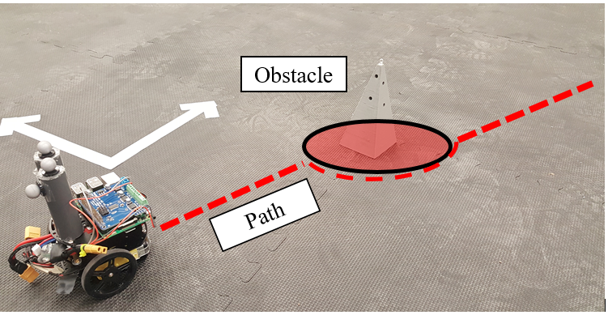
Success Criteria
Singularity / Null Guidance
Phase 1:
Phase 2:
Phase 3:
Identified location and conditions that cause vector field singularities
GVF weighted functions provide an improved performance over un-modified GVF guidance
Simulation and experimental results of modified GVF are comparable and operates in real time

Slide 14
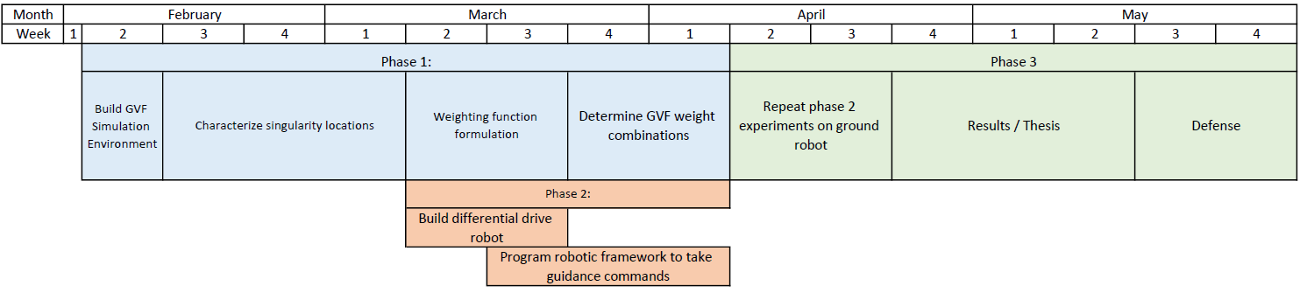
Timeline

Slide 15
Thanks
Questions?

Slide 16
Photo Sources

Slide 17
Citations

Slide 18
Appendix
Vector field loitering video
UAV states
Position, velocity
LOS, LOS rate
Range
Closing rate
How each is expecting to change field
Equations

Slide 19
Appendix
Differential drive robot
Controller
How does DDR use guidance
Carrot chasing
Dubins turn rate constraints
How are the turn rate constraints applied (guidance, controller side)
How have others emulated fixed wing on UAVs
Why does the proposed method work

Slide 20
Weight function plot
Can not avoid two fields from being equal strength

